Slide 1

How to Speak
Notes from <How to Speak> by Partrick Winston
Notes:
Your success in life will be determined largely by your ability to speak, your ability to write and the quality of your ideas, in that order.

Slide 2
How to be intriguing
Ask a question
Proper time and place
Rhetorical devices

Slide 3
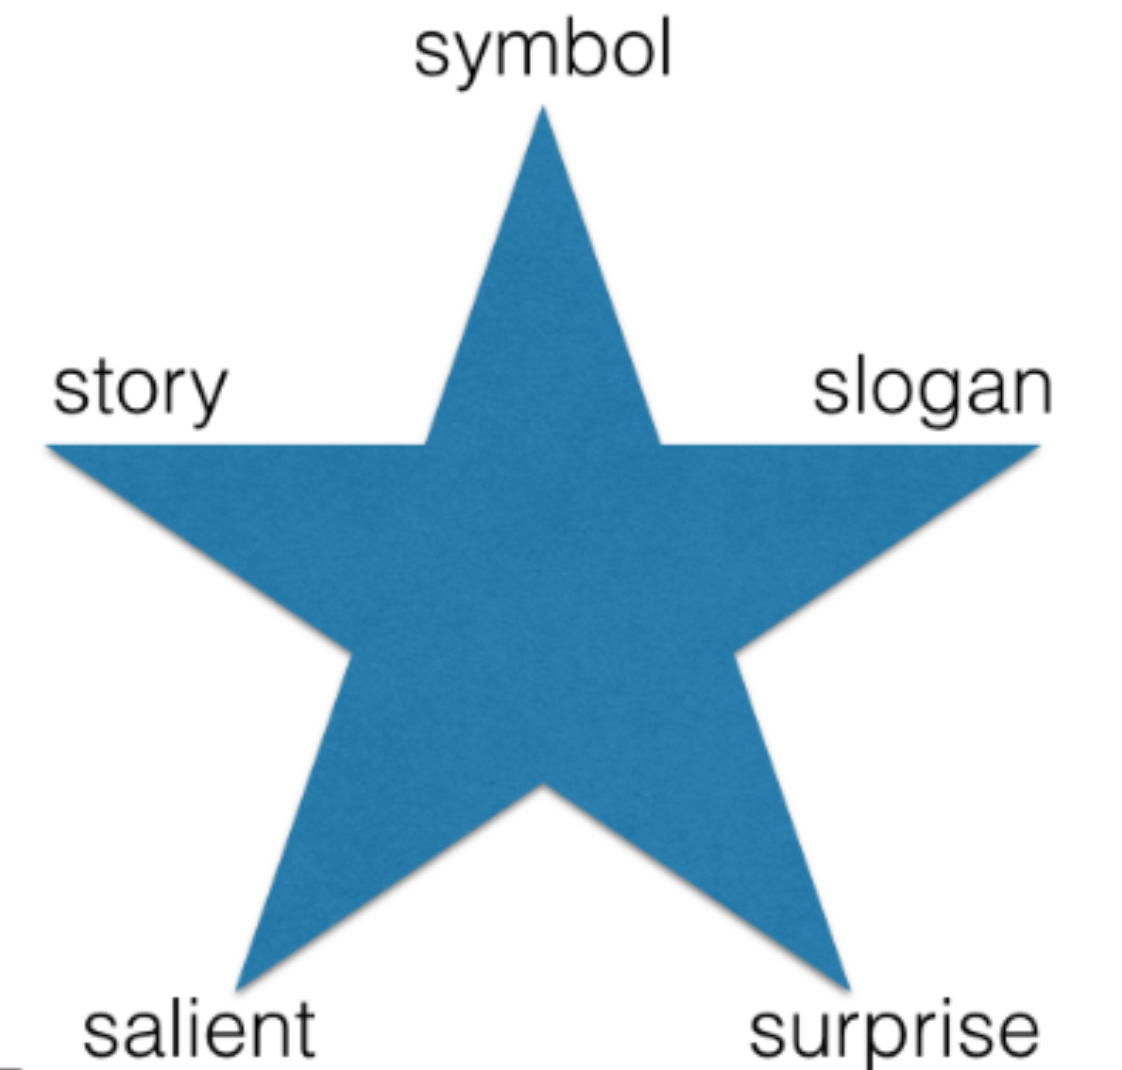
Winston’s Star
Symbol: Visible to draw attention
Slogan: Summarize your idea
Surprise: Appropriate example
Salient: Idea that sticks out
Story: You and your idea

Slide 4
Start with a promise
Build a fence
Ask a question
Use board for graphic and speed
Slim slide and be in the image
Tell a good story

